Slide 1


Mobile Application Development
Roshan David Jathanna
roshan.jathanna@manipal.edu

Slide 2
References
Miola, A., 2020. Flutter Complete Reference: Create beautiful, fast and native apps for any device.
https://flutter.dev/learn
https://github.com/rodavid20/Flutter2023

Slide 3

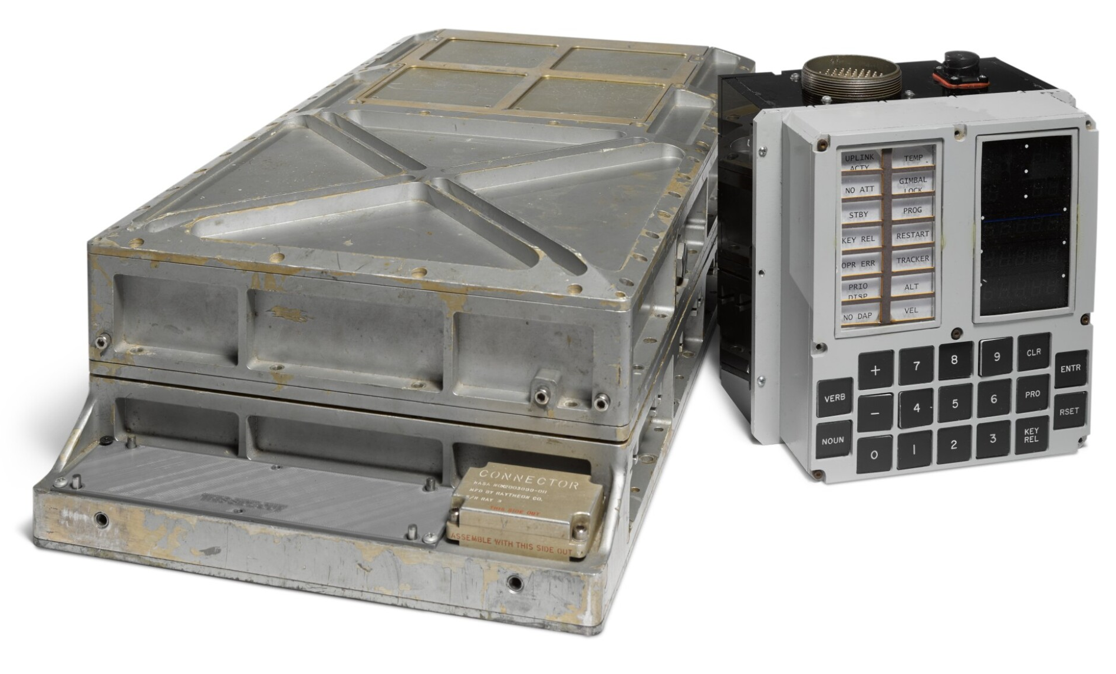
Can you guess?
Notes:
The Apollo Guidance Computer had RAM of 4KB, a 32KB hard disk. It was fairly compact for its time, measuring 60cm x 30cm x 15cm, but weighed around 30kg. Current computers are much lighter, at least 1000 times as fast and have storage capacities that are millions of times those achievable in 1969.
38K Memory
Apollo 11 mission of July 16-24, 1969,
one small step for man, one giant leap for mankind,”
The AGC’s processor was many thousands of times less powerful than the processor in your smartphone, yet it was still able to land people on the moon.

Slide 4
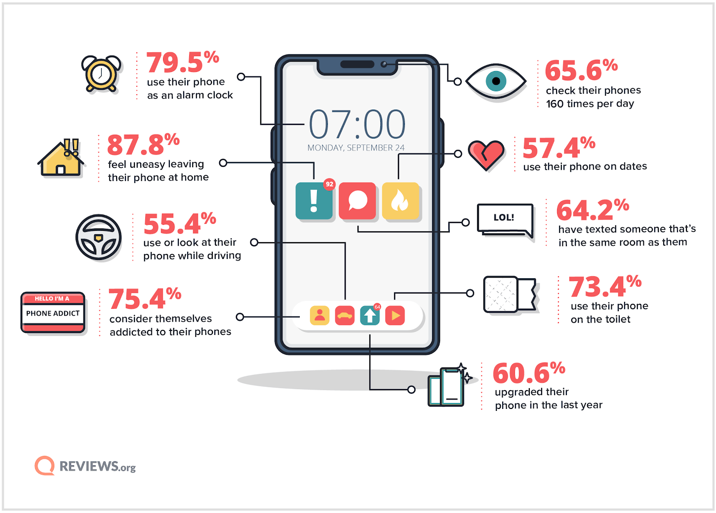
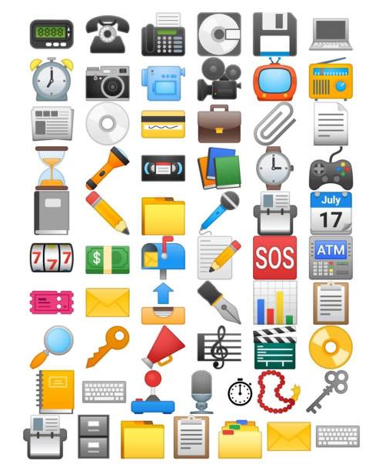
American Survey 2022
Ref: https://www.digitalinformationworld.com/2020/03/smartphone-addiction-statistics.html

Slide 5
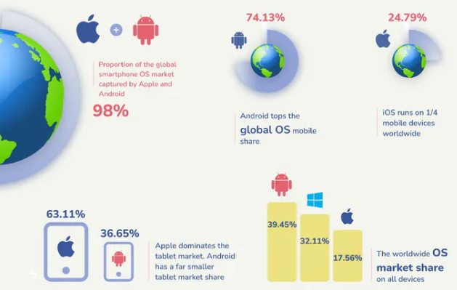
Mobile Platforms & OSs
Ref: https://root-nation.com/en/news-en/en-android-ios-market-share/

Slide 6
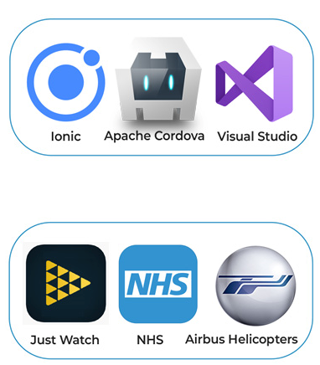
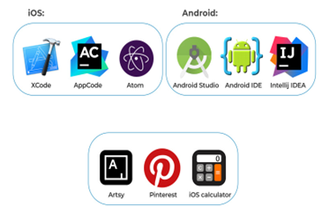
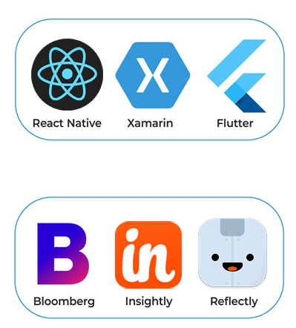
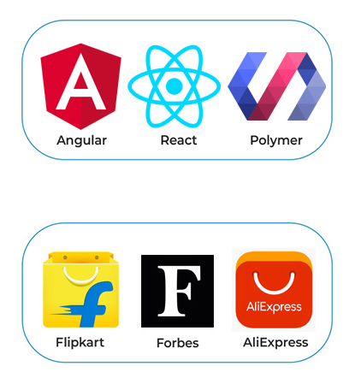
App Development Approaches
3. Hybrid
Ref: https://railsware.com/blog/native-vs-hybrid-vs-cross-platform/amp/
1. Native
2. Cross Platform
4. Progressive Web

Slide 7
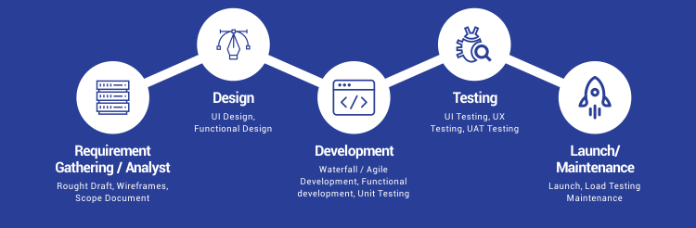
App Development Lifecycle
Ref: https://www.itrobes.com/mobile-app-development-lifecycle

Slide 8

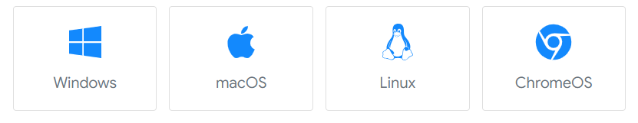
Installation – VS Code
https://docs.flutter.dev/tools/vs-code
Notes:
Creating a new project
To create a new Flutter project from the Flutter starter app template:
Open the Command Palette (F1, Ctrl+Shift+P (Cmd+Shift+P on macOS)).
Select the Flutter: New Project command and press Enter.
Select Application and press Enter.
Select a Project location.
Enter your desired Project name.
Opening a project from existing source code
To open an existing Flutter project:
Open command palette Cmd-Shift-P -> Type Emulator. ctrl+shift+p. then type. Flutter:launch emulator. Run this command in your VS code terminal flutter emulators
Click File > Open from the main IDE window.
Browse to the directory holding your existing Flutter source code files.
Click Open.
Click Run > Start Without Debugging in the main IDE window, or press Ctrl+F5.
Open the launch.json file in VS Code.
If you do not have a launch.json file, go to the Run view in VS Code and click create a launch.json file.
In the configurations section, change the flutterMode property to the build mode you want to target.

Slide 9
Installation – VS Code Extensions
Flutter
Dart
Awesome Flutter Snippets
Pubspec Assist
Error Lens
Dart Data Class Generator
Material Icon Theme - Set File Icon Theme

Slide 10
Installation
https://docs.flutter.dev/get-started/install
Notes:
Download Flutter SDK
Extract the zip file and place the contained flutter (Don’t have special characters)
add Flutter to the PATH environment variable (flutter\bin)
where flutter
flutter doctor
Agree to Android Licenses
flutter doctor --android-licenses

Slide 11
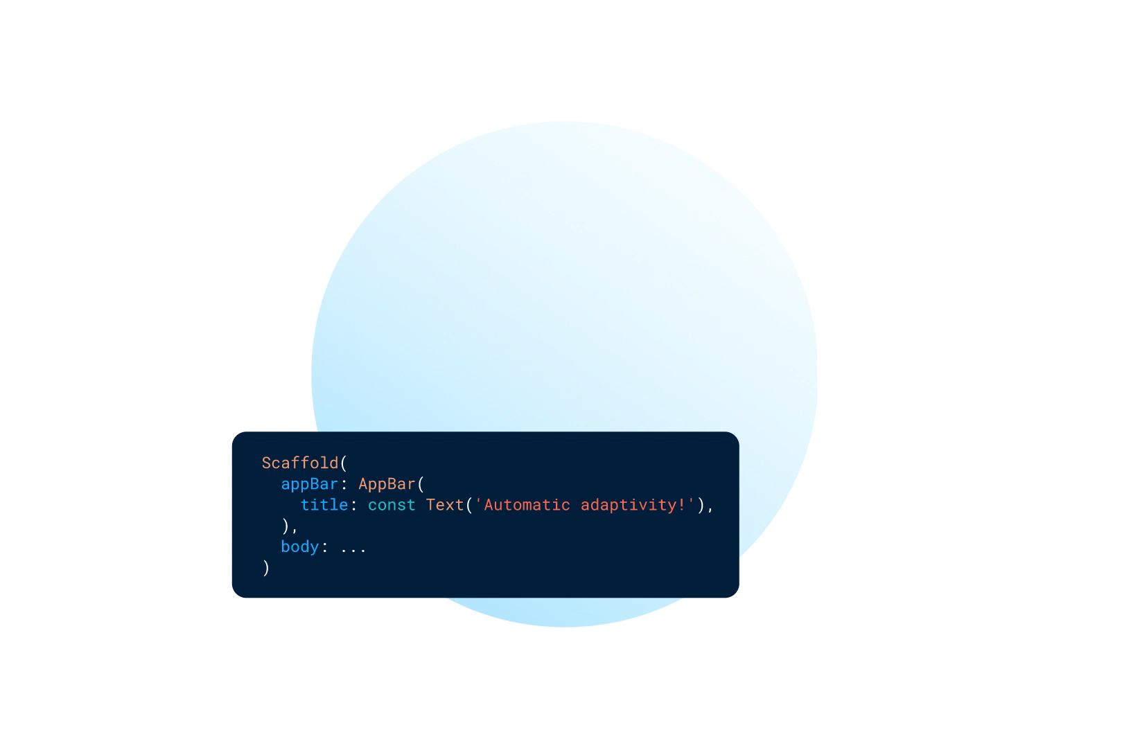
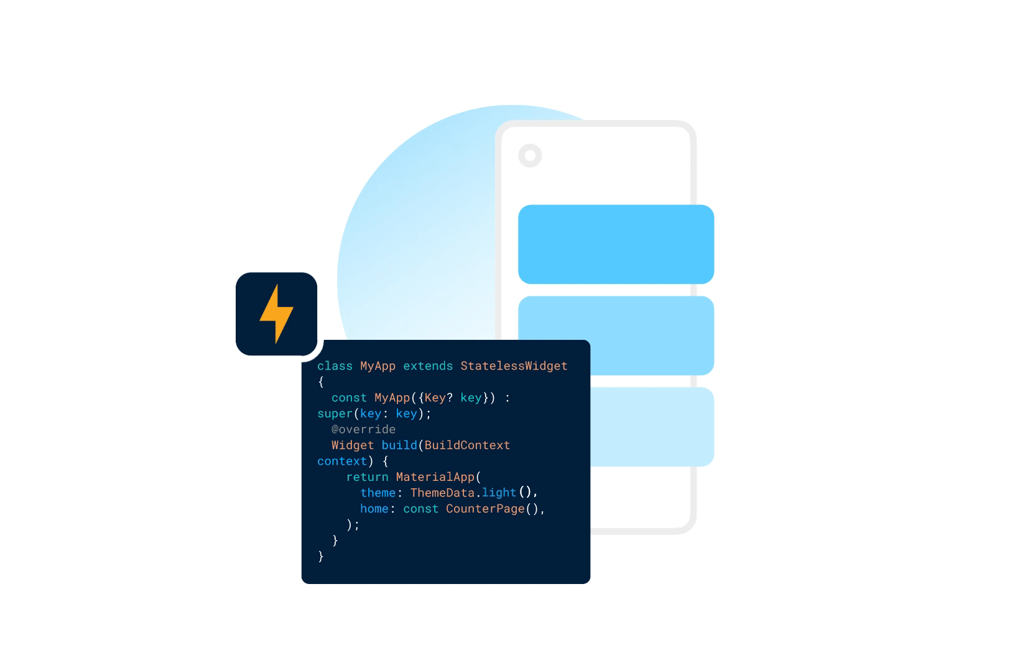
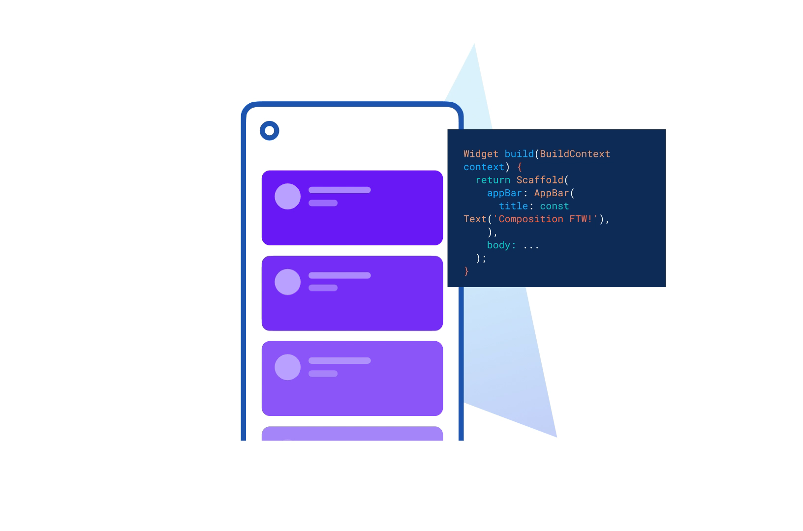
Why Flutter
Flexible
Productive
Fast
Notes:
Fast
Flutter code compiles to ARM or Intel machine code as well as JavaScript, for fast performance on any device.
Productive
Build and iterate quickly with Hot Reload. Update code and see changes almost instantly, without losing state.
Flexible
Control every pixel to create customized, adaptive designs that look and feel great on any screen.

Slide 12
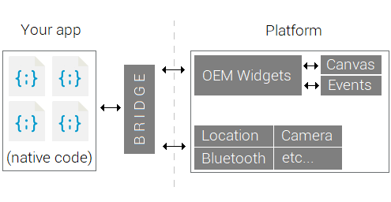
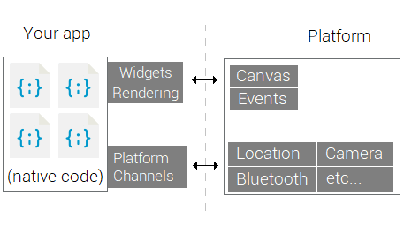


How does it work
Notes:
The bridge always exposes the same interface to the apps, so that it doesn't care anymore about the OS it's running on.
The bridge approach is quite popular, but it could be a potential bottleneck that slows down the execution, and thus the performance might drop.
Flutter produces native ARM code for the machine.
When launched, the app loads the Flutter library. Any rendering, input, or event handling, and so on, is delegated to the compiled Flutter and app code. This is much faster than having a bridge.
The true power of Flutter lies in the fact that apps are built with their own rendering logic and they are not constrained to paint the UI following the rules "imposed" by OEM widgets. You're free to control the screen and manipulate every single pixel.

Slide 13




Why Dart
Object-Oriented Programming (OOP) Style
Performance
Productivity
Both Flutter and Dart are developed by Google
Notes:
Why Flutter uses Dart
Object-Oriented Programming (OOP) Style:
Performance
Dart can guarantee to be very efficient, and it provides a powerful memory allocator that handles small, short-lived allocations. This is perfect for Flutter's functional-style flow.
Productivity
Flutter allows developers to write Android, iOS, web, and desktop apps with a single code base, keeping the same performances, aspect, and feeling in each platform.
Both Flutter and Dart are developed by Google, which can freely decide what to do with them, listening to the community as well.

Slide 14
Dart
List.ForEach
Named, Positional parameter
Import
Classes
Encapsulation
Named constructor
Cloning
Extends, implements, mixins
Exceptions
Map, Spread
Asynchronous
int, double, bool, String
final, late, const
parse, tryParse, toString
enum
List<>
Nullable type
If else, switch, for, for-in, while
function, anonymous

Slide 15
Tutorial 1
Find the number in the list
Find the shortest string in the list
Create gender as an enumerated list and show its usage
Create a Person class in Dart with the following properties:
firstName, lastName, age
Include a constructor to initialize these properties and a method named printDetails that prints the full name and age of the person.
Then, create two instances of the Person class and call the printDetails method on each instance.

Slide 16
Tutorial 2
You are building a basic game engine in Dart for a platformer game. You have various types of game objects, each with their own unique behaviors. Implement the following scenario using class inheritance, mixins, and interface implementation.
You have three types of game objects:
GameObject: The base class that all game objects inherit from. It has properties like x and y coordinates.
Movable: A mixin that provides the ability to move a game object. It has methods like moveLeft(), moveRight(), moveUp(), and moveDown().
Drawable: An interface that defines the draw() method.

Slide 17
Tutorial 2 (Contd)
Additionally, there are two types of game objects that inherit from GameObject and use the Movable mixin:
Player: A game object representing the player character. It implements the Drawable interface and has an additional method, jump().
Enemy: A game object representing an enemy. It implements the Drawable interface and has an additional method, attack().
Your task is to define these classes and their relationships, utilizing class inheritance, mixins, and interface implementation.

Slide 18
Tutorial 2 (Solution)

